Slide 1
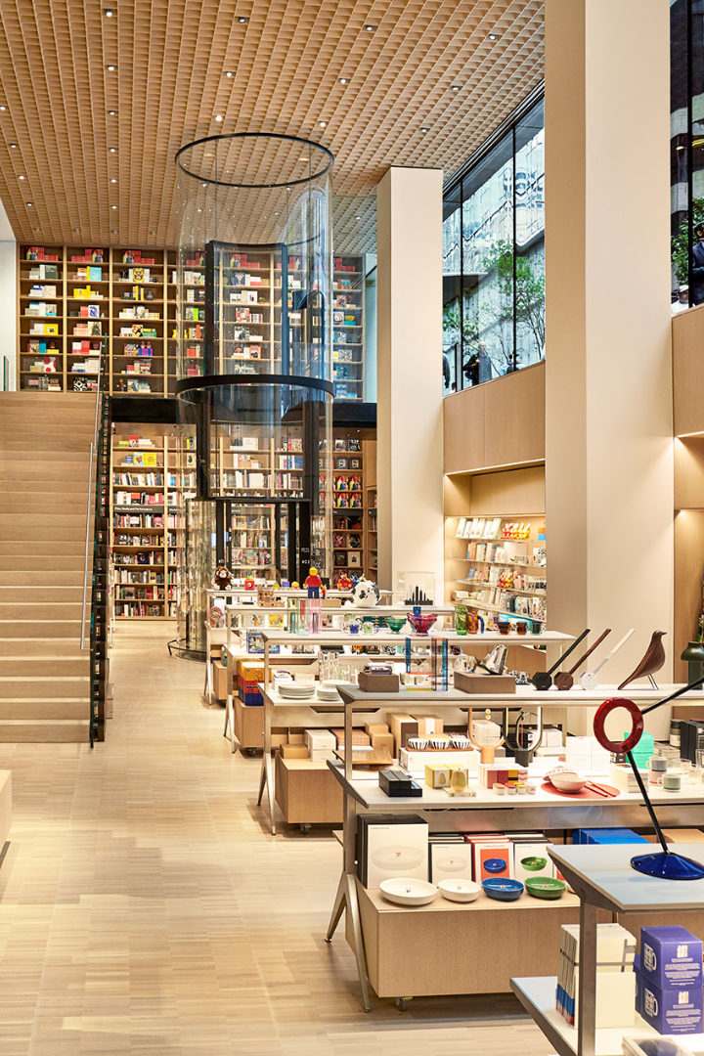

Retail Inventory Management Analysis
Welcome to our presentation on retail inventory management analysis. We will guide you through the key steps to effectively manage your inventory.

Slide 2

Our Team
Ganesh (Data Engineer)
Adithya Sai (Data Scientist)
Vamsi (Data Modelling)
Brahma Vamsi (Data Visualization)

Slide 3
Statement of Project Objectives: To make a model that predicts the sales of our stores based on customer inputs with perfect accuracy To make a model which is perfectly beneficial for customer and retailer and to encourage small businessman

Slide 4
Data source and Distribution
Data source collected from Kaggle.
Contains various stores data in the years from 2016 to 2023

Slide 5
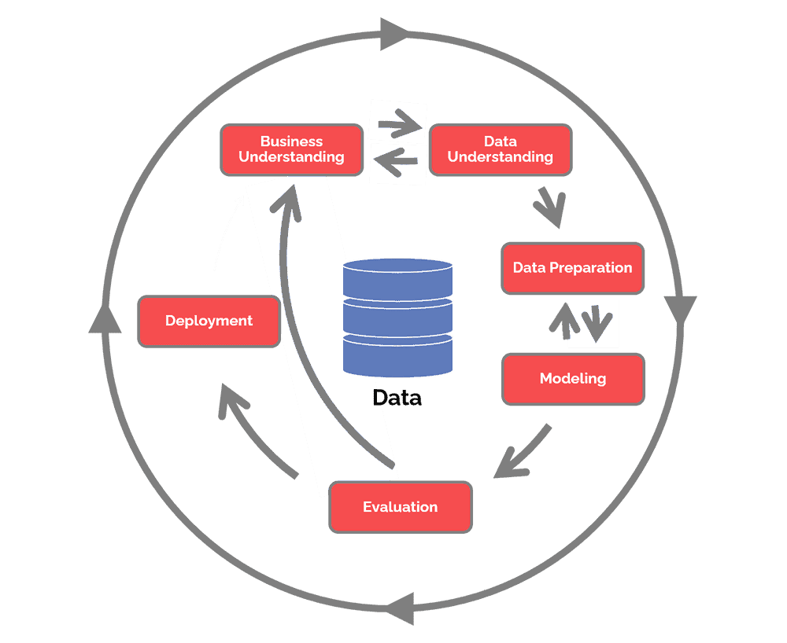
Our process CRISP DM Methodology

Slide 6

Business Understanding
1
Identify Goals
From business perspective,if we know under what circumstances the reatail increases ,we can increase the sales
Market Research
2
Conduct market research to identify customer demands and trends.
3
Competition Analysis
Analyze your competitors' inventory strategies to gain a competitive edge.
Optimize Stock Levels
4
Determine the right stock levels to meet customer demands and minimize costs.

Slide 7

Data Understanding
1
Data Collection
2
Data Analysis
3
Data Visualization
Gather relevant data on sales, stock levels, weekly sales ,holidays and customer behaviors.
Analyze the collected data to identify patterns and insights about inventory performance.
Use charts and graphs to present the analyzed data in a visually compelling way.
Transforming numerical input variables into probability distributions that are Gaussian or more Gaussian-like.Feature Selection and Correlation Analysis

Slide 8
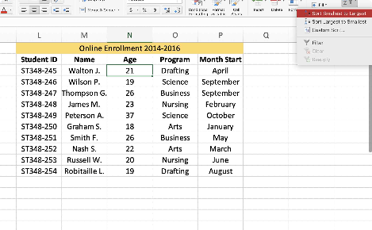
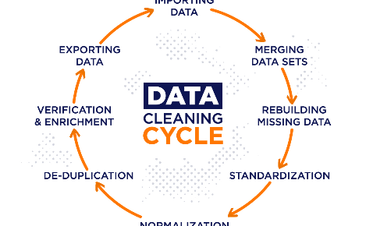
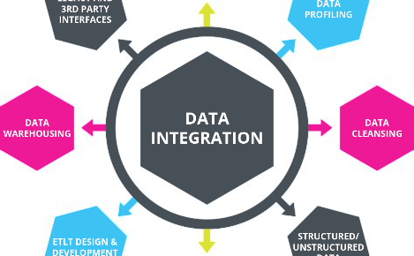
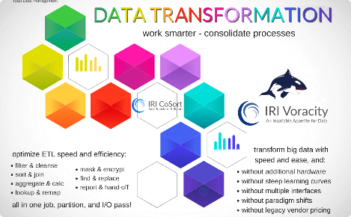
Data Preparation
Data Sorting
Data Cleaning
Sort and organize the data to ensure accuracy and ease of analysis.
Remove any inconsistencies and errors from the data to improve its quality.
Data Integration
Data Transformation
Combine data from different sources to get a comprehensive view.
Convert data into a suitable format for modeling and analysis.

Slide 9

Modeling
1
Choose Models
We have used Linear Regression technique to model for accurate predictions.
2
Weekly Sales
Weekly Sales field is the target variable and the fields include gender,
Customer id, quantity ,price etc.
3
Simulation
Simulate inventory scenarios to understand the impact of different factors.

Slide 10

Evaluation
For the evaluation purpose we used the accuracy score from the Linear Regression Model itself. We divided the data into training sets and testing sets. - trained the model using 70% of data and tested the model using 30% of data. Got accuracy of 97.14%%.

Slide 11

Deployment
Deployed the model in the web using the flask. The model can be accessed via https://github.com/orgs/Team-DS01/repositories
Taken inputs for fields as customer age, quantity, price, gender, age, payment
method and invoice data
.

Slide 12
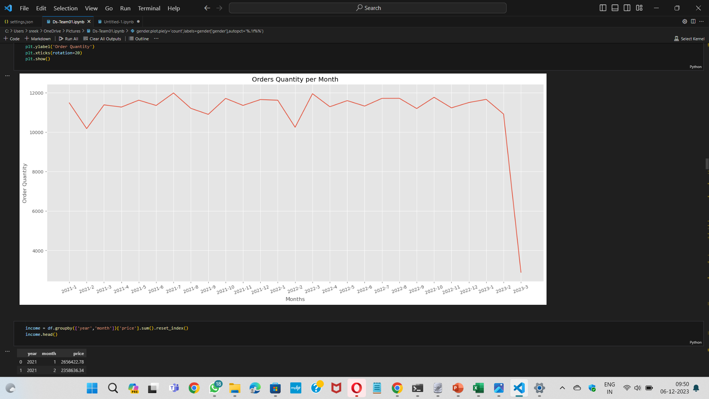
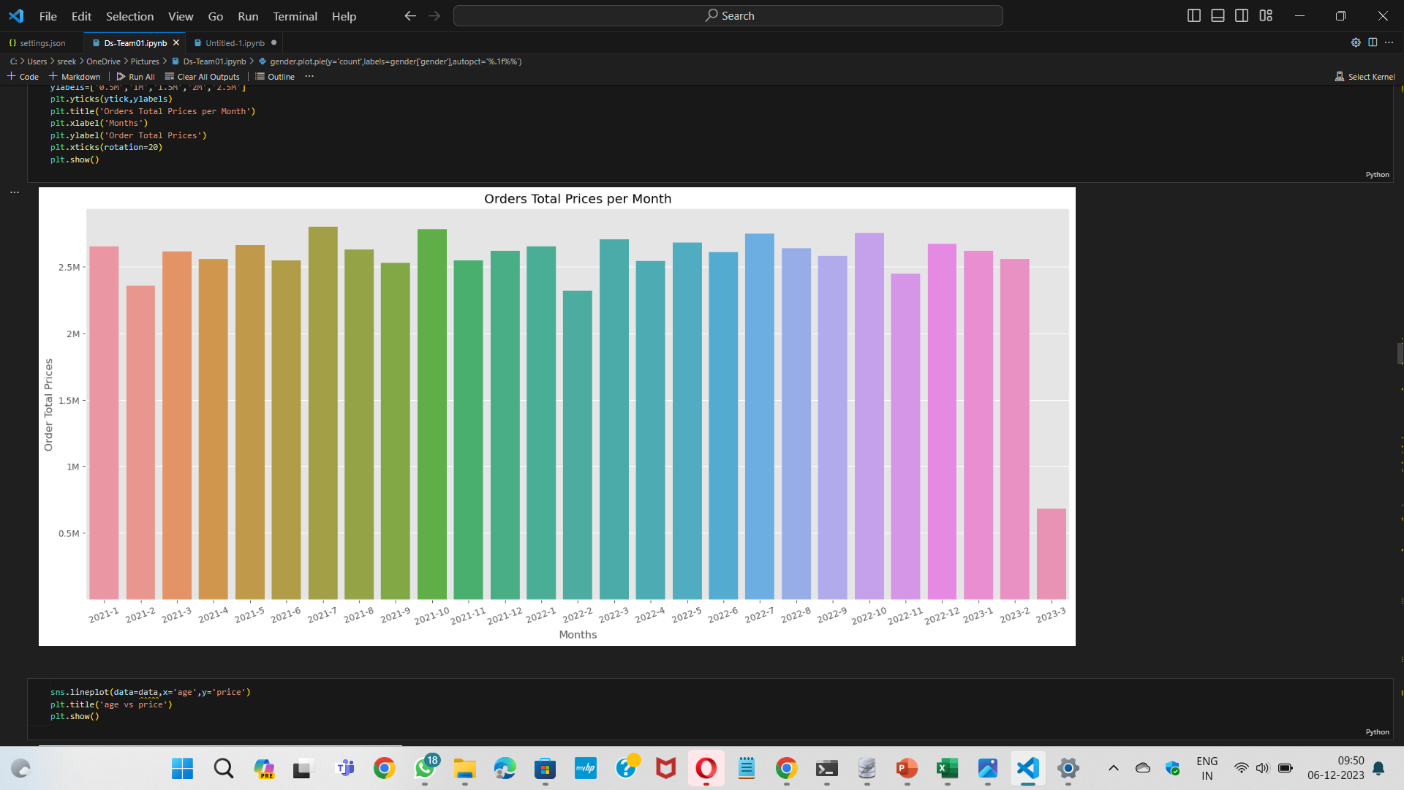
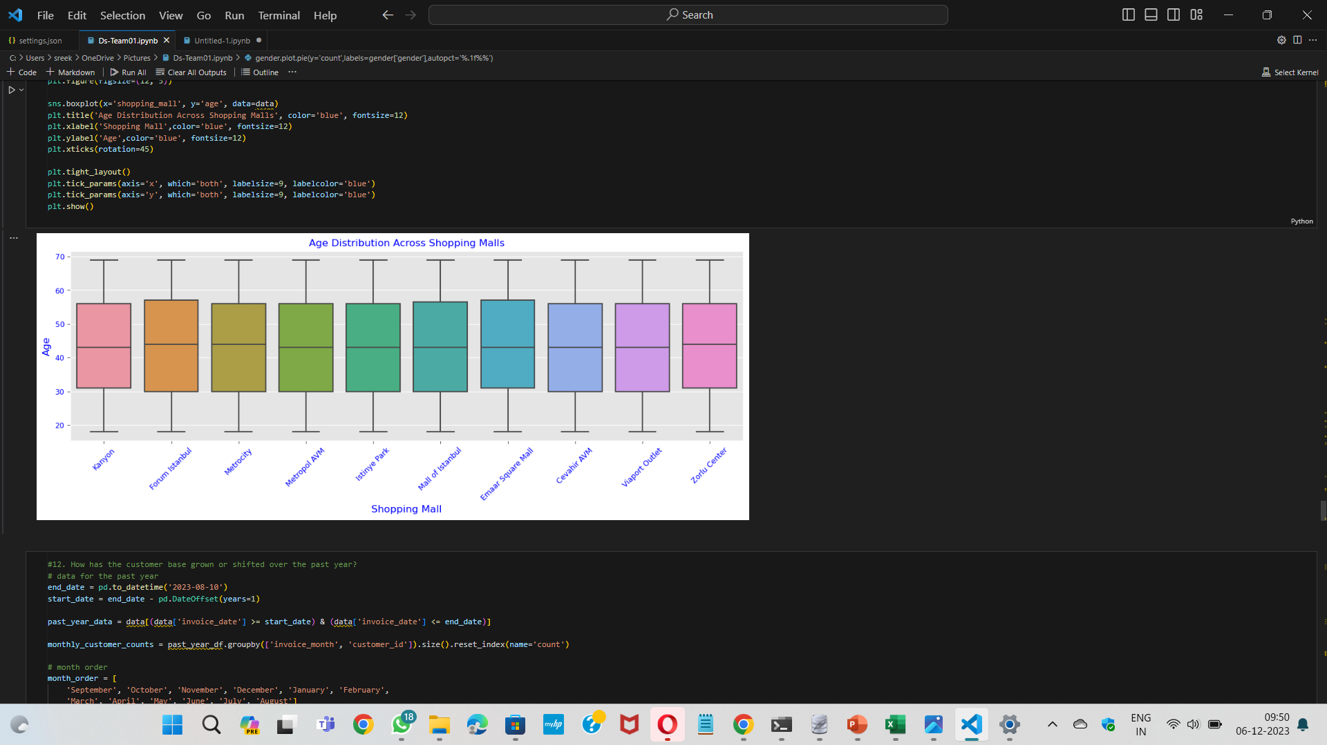
Orders quantity per month
Orders price per month
Age distribution
We collected how many orders are there in particular month so that we can modify the goods according to monthly sales
With these graphs we came to know how much revenue is generating per month
With these, many shopping malls can know which age group are visiting stores and it will helpful for retailers

Slide 13
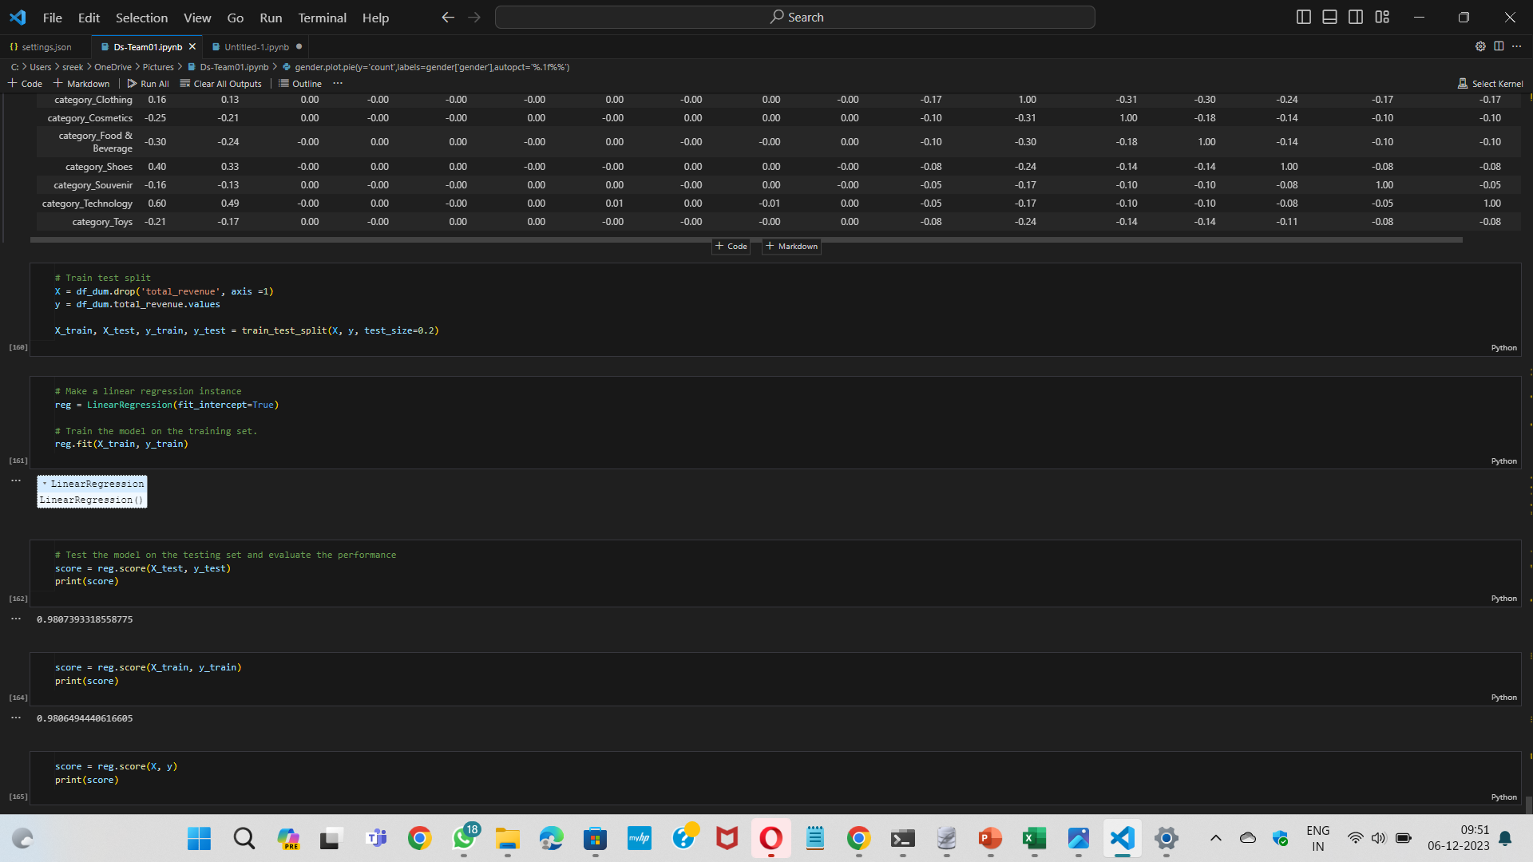
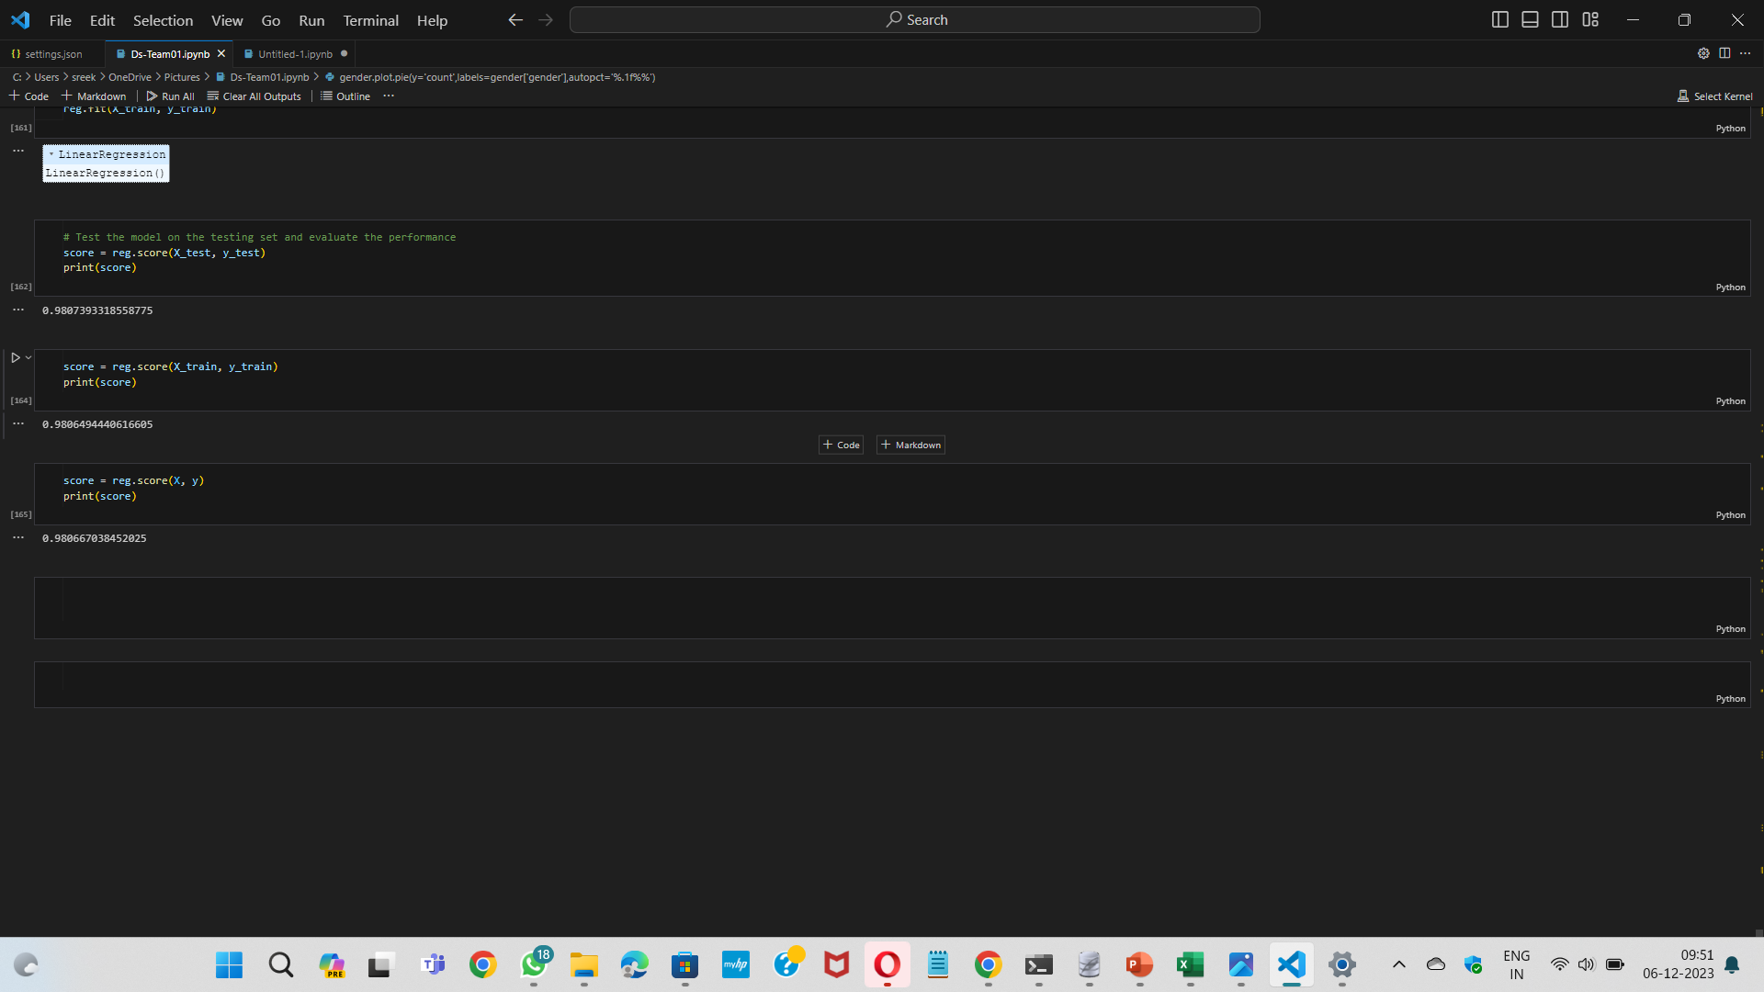
Training and testing models
Accuracy score
We trained and tested these models as shown in the above graph
We got accuracy of 97.16% by training and testing the modles

Slide 14
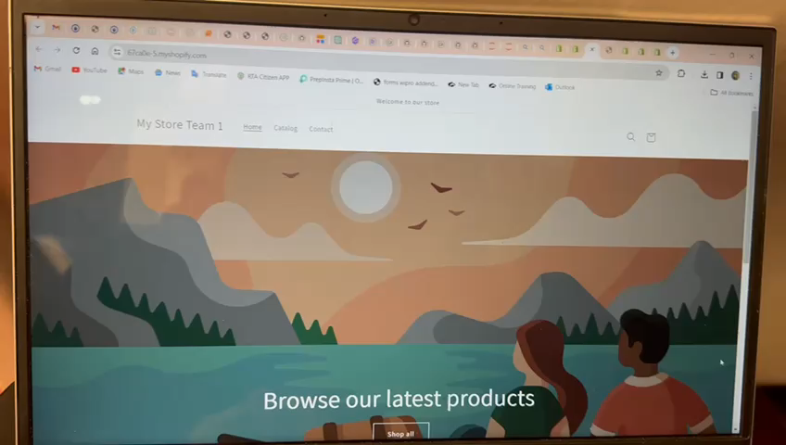

Slide 15

Future Predictions
Use advanced analytics and artificial intelligence we can bring more benefits to the custiomers as well as price holders by encouraging small businessman .With these predictions we can create employee oppurtuinities for various domain people.

Slide 16


